Slide 1
Practices Short Circuit Model
Jerry Richards Bonneville Power Administration
August 30, 2017
Salt Lake City, Utah

Slide 2
Fault Study Model & Misoperations
The Power Grid is a Mysterious Cloud.
Don’t be Surprised by the Cloud.
Use your tools to See into the Cloud.
It’s not just Local it is What’s Remote.
Accurate Models Minimize Misoperations.

Slide 3
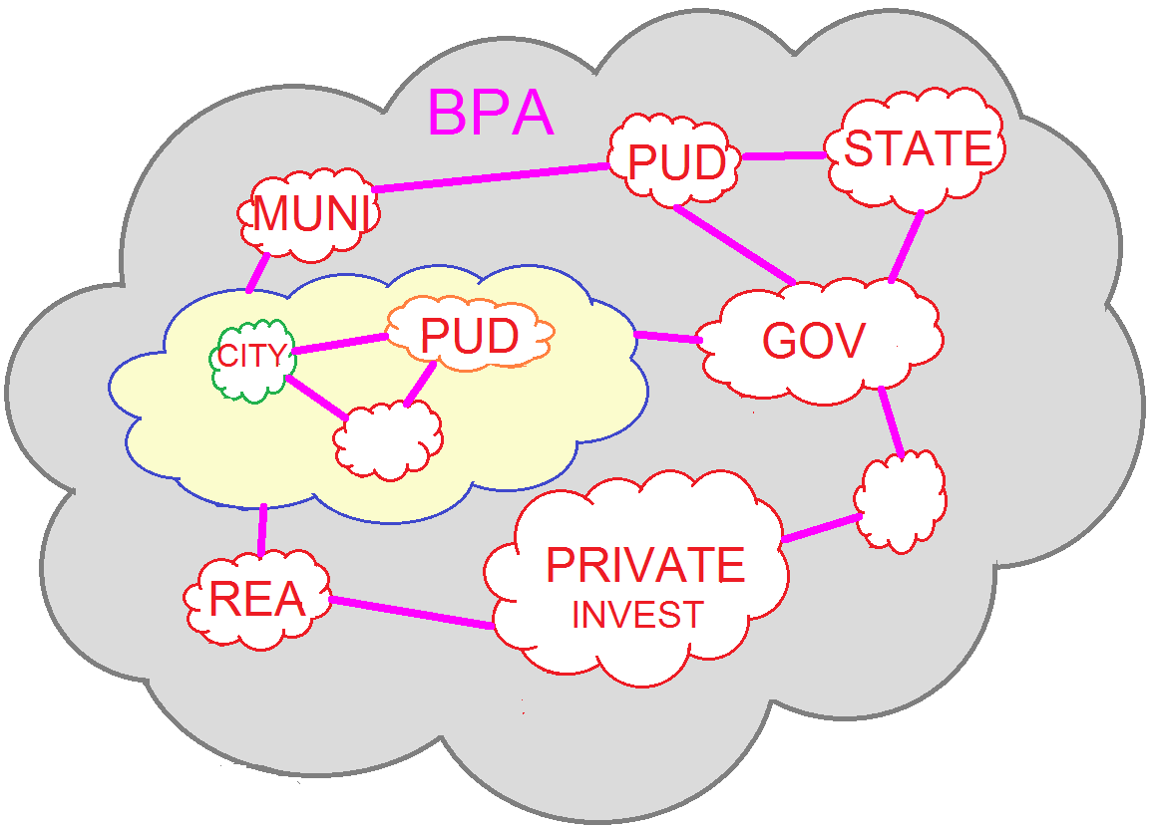
Northwest Power Grid Cloud

Slide 4
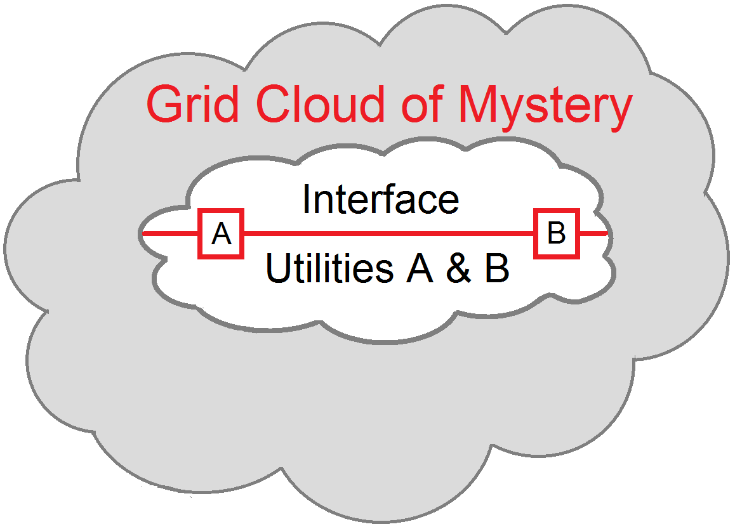
Given Large Power Grid

Slide 5
Cloud Equivalent
Original Thinking:
Only Need Remote Source Contribution.

Slide 6
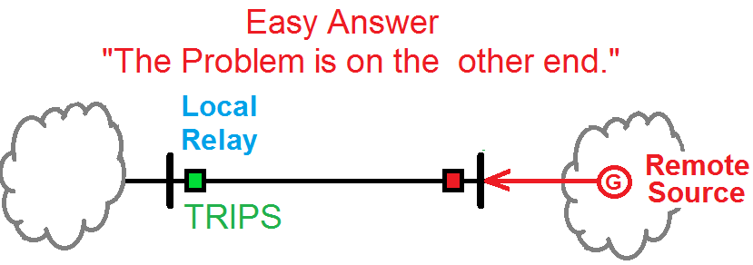
Cloud Tripping Post Analysis
What happens when Your Local Relay trips ?
Is this Normal ?
Has something Changed ?
What is in that Cloud ?

Slide 7
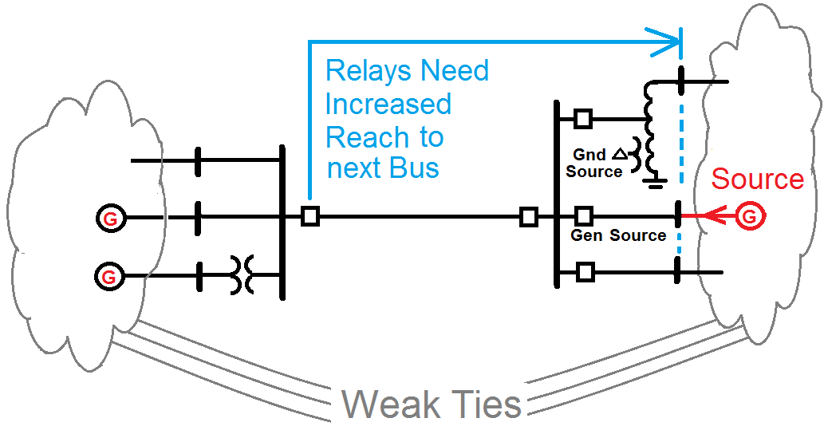
Relays need to Reach Into the Cloud

Slide 8
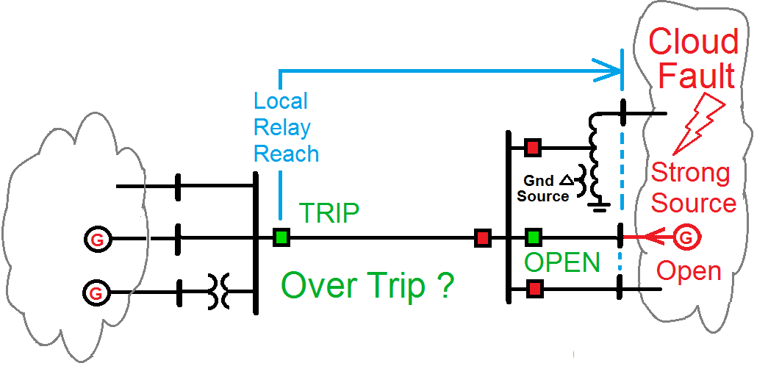
Shrink the Clouds
Relays Need to see Further into the Remote Cloud.
What if Remote Strong Source was Out of Service ?

Slide 9
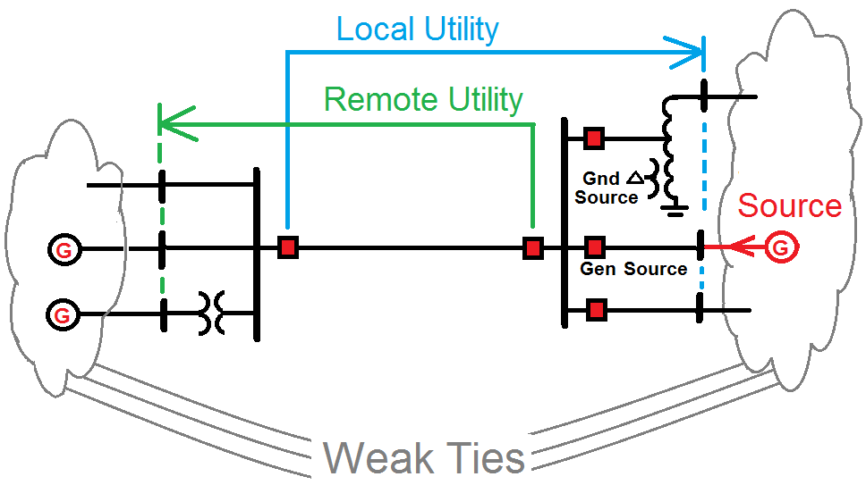
Relays need to Reach Into Cloud

Slide 10
Fault Model Premise
For Each Utility’s Model at Utility Boundaries.
The Remote Bus Faults Need To Agree.
Each Utility Needs More than the Next Bus.
Models Need to be flexible for upgrades.

Slide 11
What is needed in a Regional Model
Each Utility is normally only interested in its own model and includes only as much as the neighboring model as necessary.
The unwanted portion of the regional model could be reduced to an equivalent for the local utility.
The unwanted portion can remain in a hidden layer. THE PREFRED METHOD.

Slide 12
History of BPA Regional Model
About 20 years ago many Northwest Utilities were using ASPEN OneLiner
At a WPRC meeting it was decided to start sharing the various Utility Models.
A Regional model would be needed
A manager of the model would be needed
BPA agreed to be that manager

Slide 13
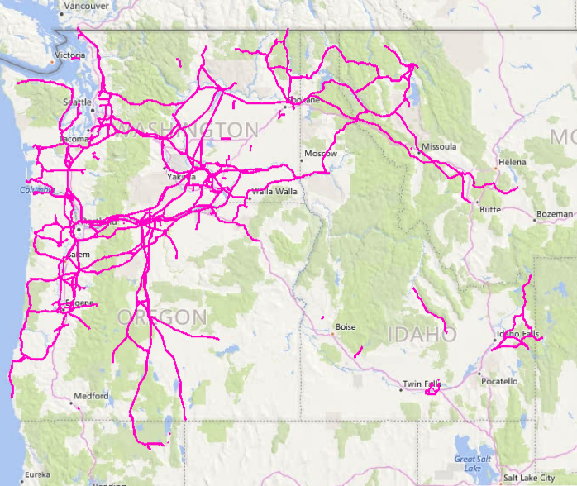
Constructing BPA Regional Model

Slide 14
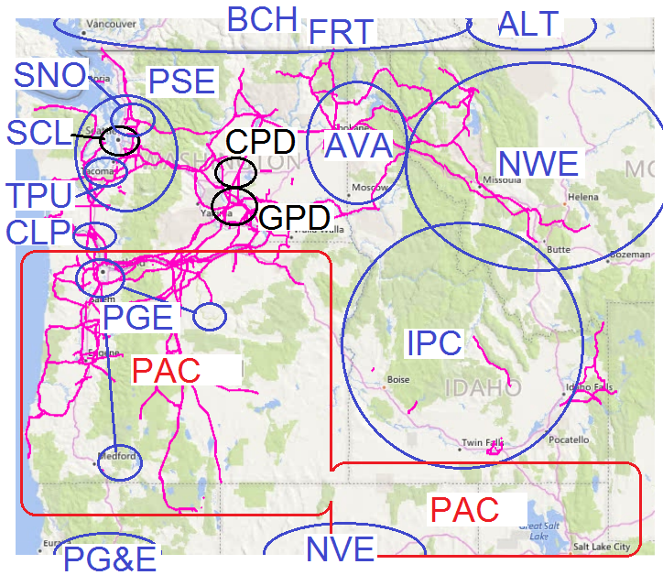
Major Utilities in BPA Model

Slide 15
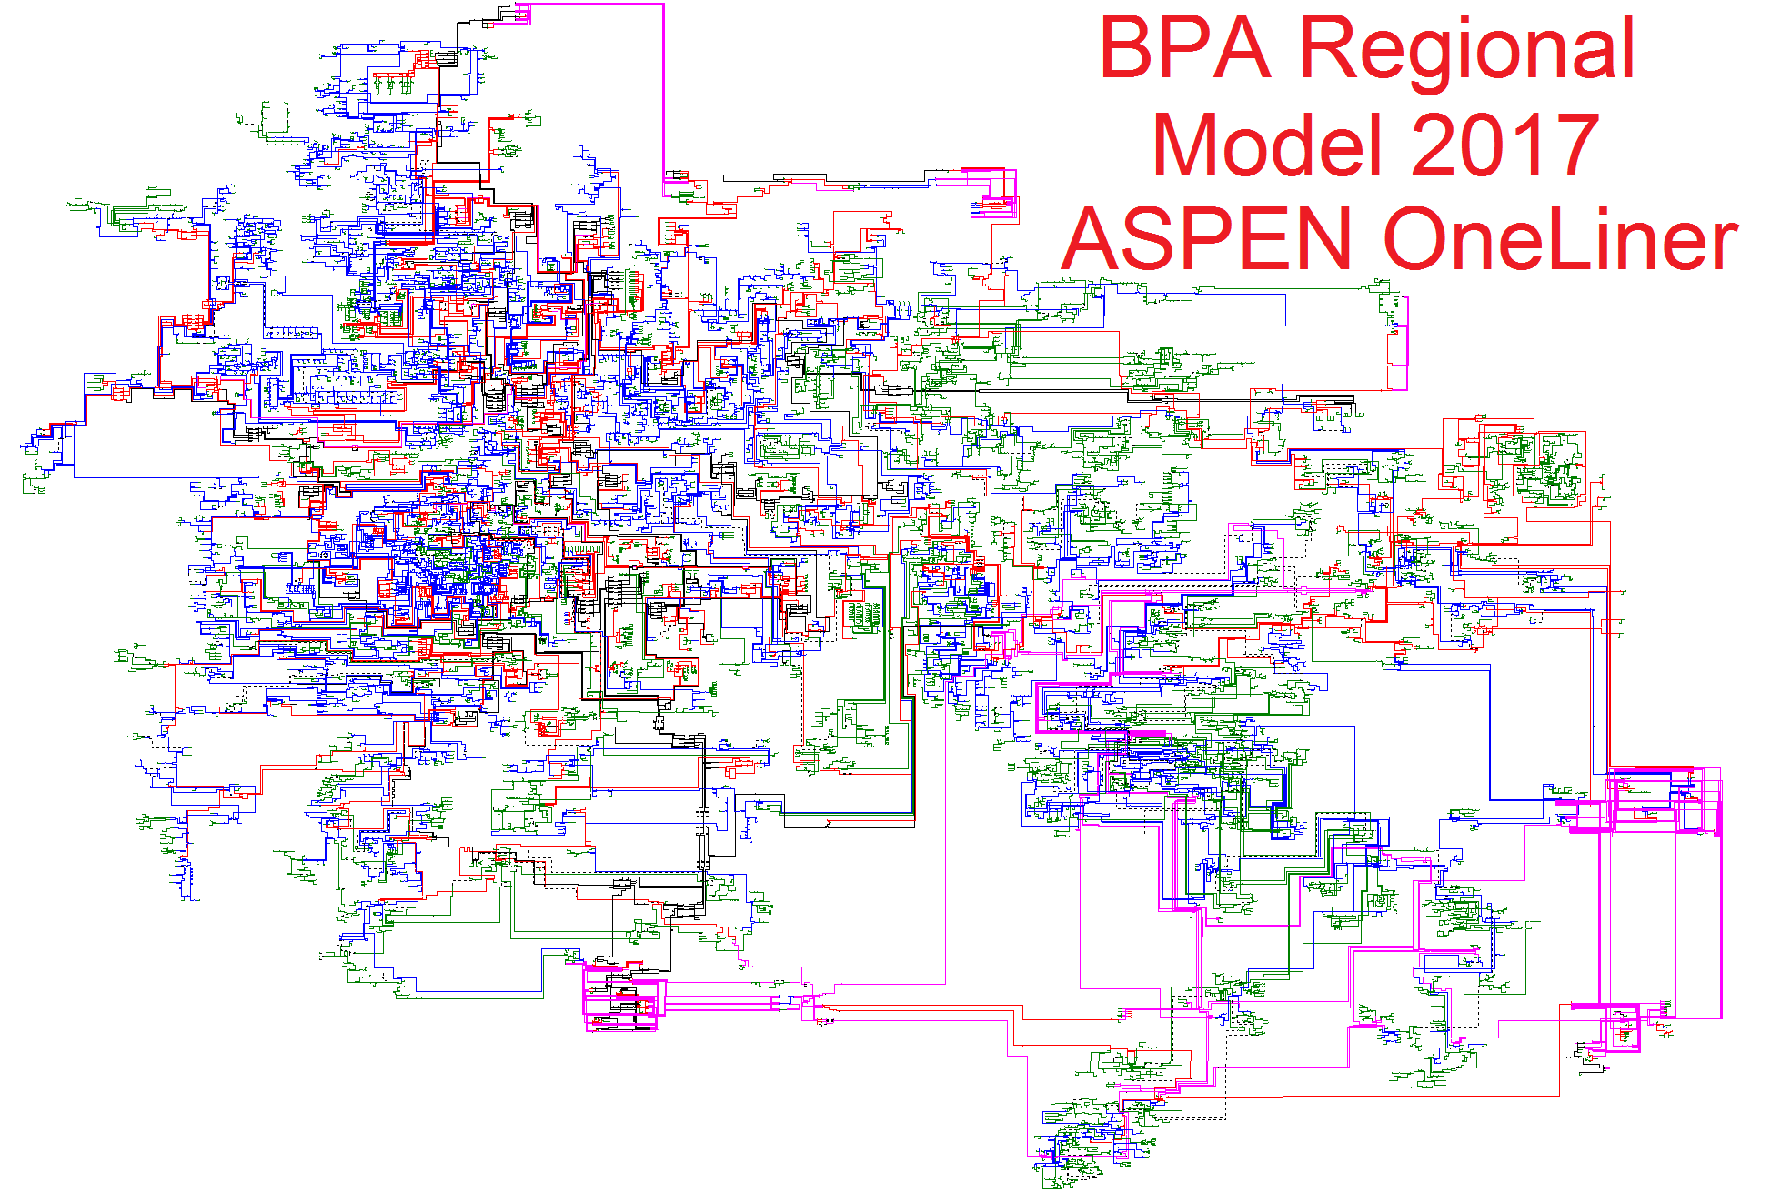

Slide 16
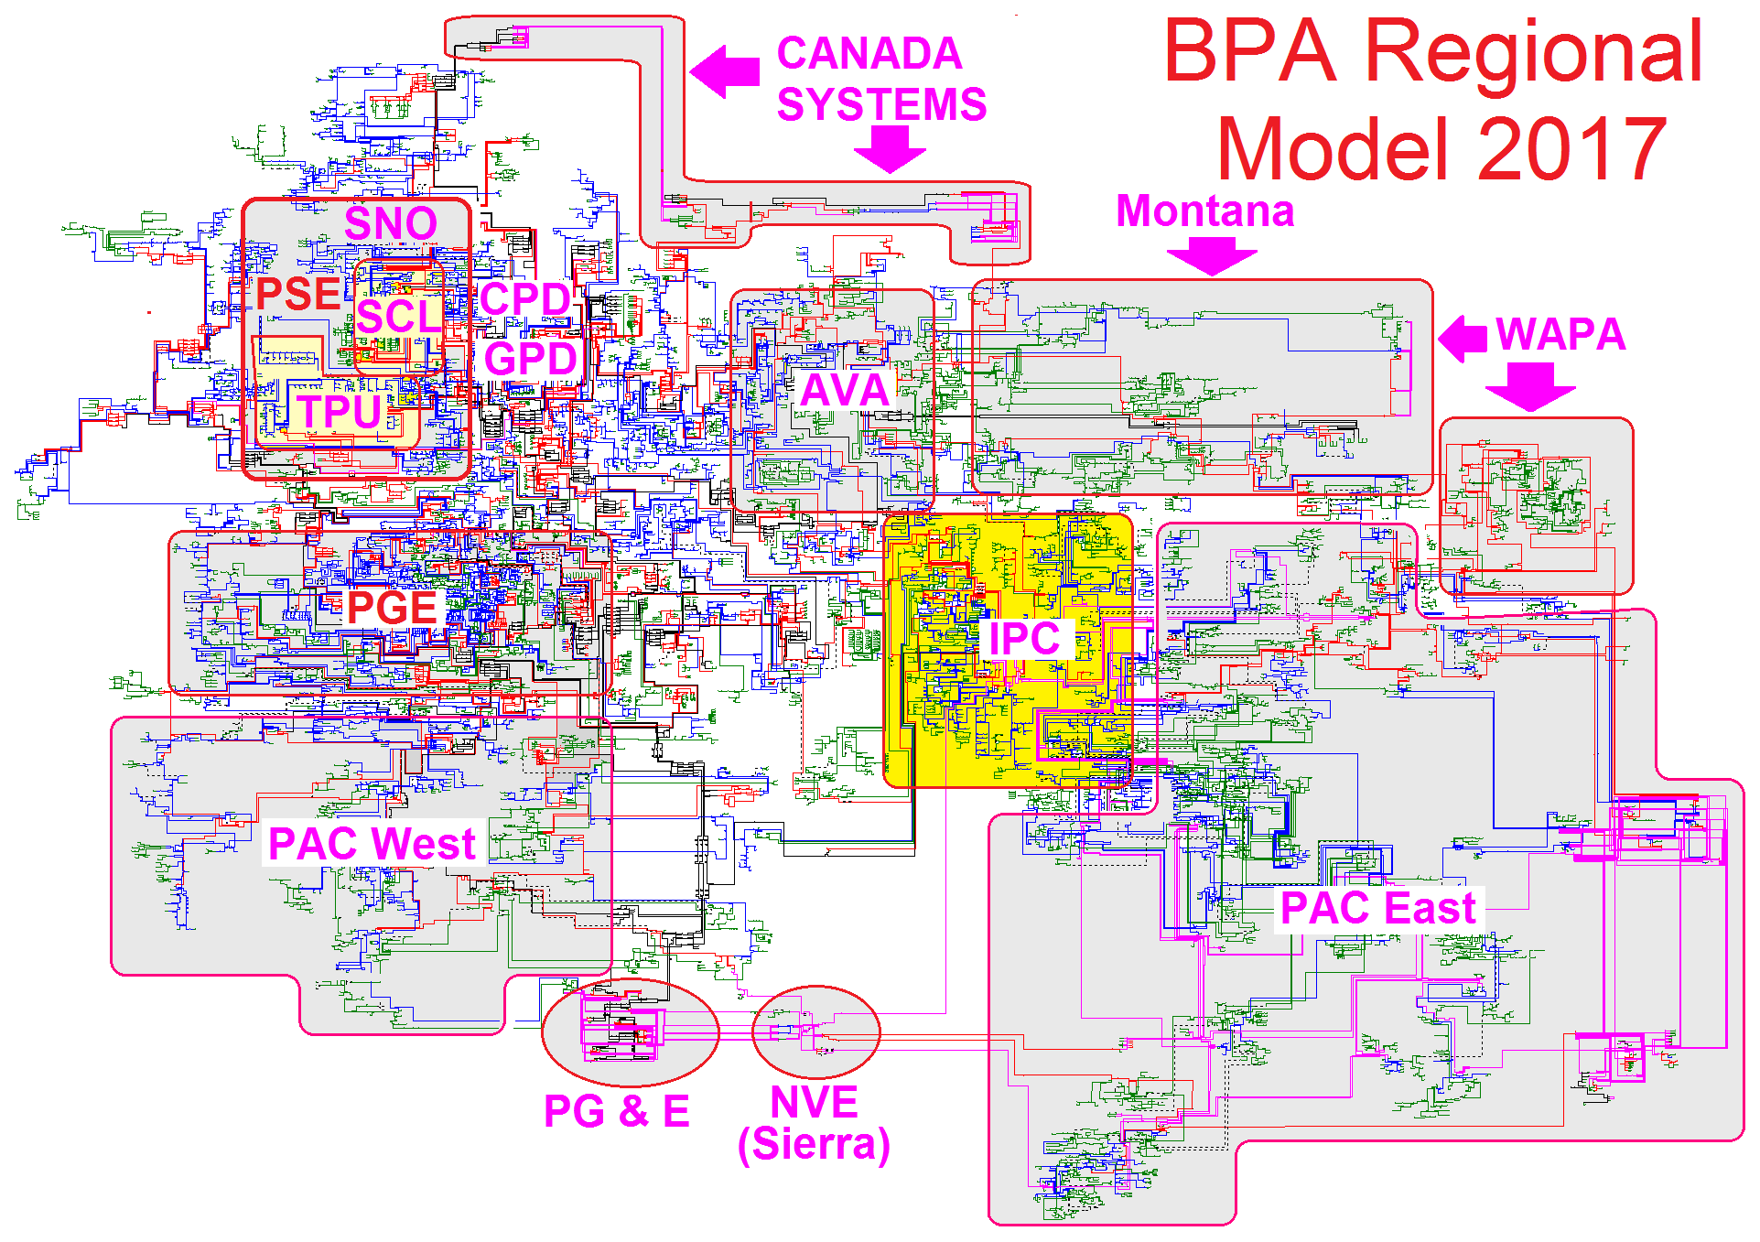

Slide 17
Why Use Full Regional Model ?
Easier to Update with Changes.
Permits overlapping of neighboring systems for post analysis of faults at Utility Boundaries.
Produces agreeable fault duties at boundaries 3 to 7%.
Utility can hide Regional Portions not wanted.
Inter-Utility Mutual Impedance data is retained.

Slide 18
Local Utility Use of Regional Model
Each Utility has its own identifier number.
BPA regional Model uses Bus Zone number to identify Utility Ownership.
Local Utility can Hide all Foreign Buses.
Local Utility can Un-Hide next foreign Buses as needed in its own model.

Slide 19
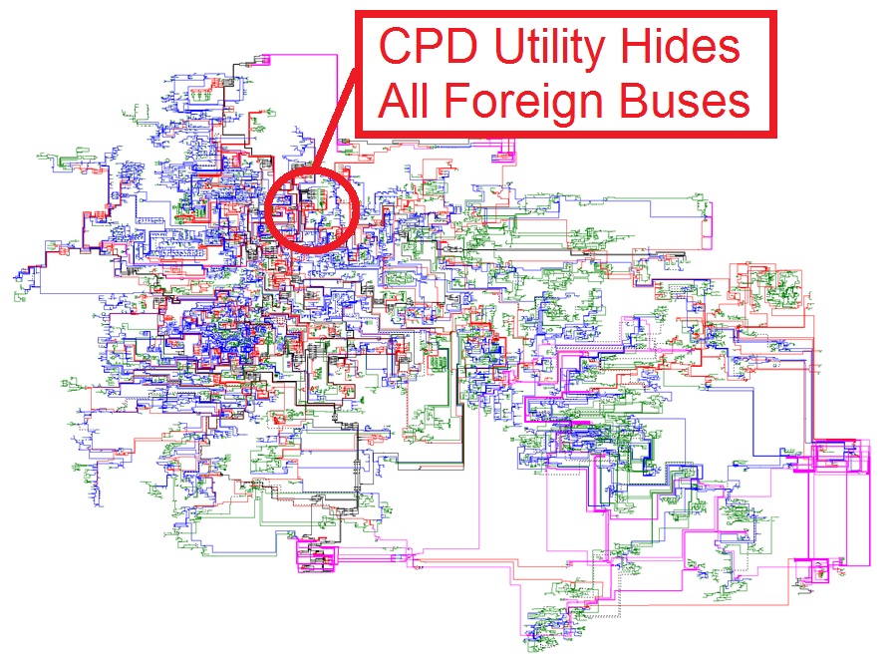

Slide 20
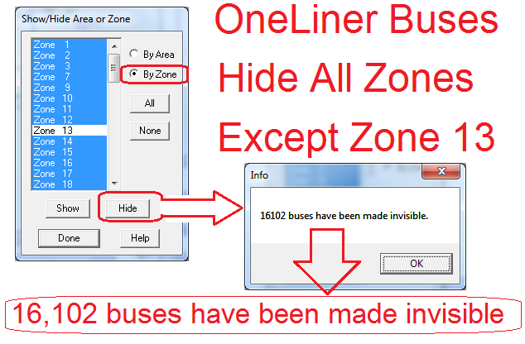
Hide Unwanted Regional Buses

Slide 21
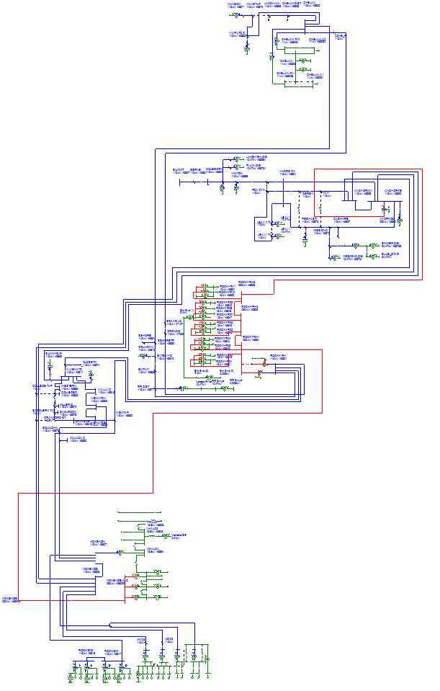
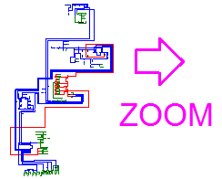
Zone 13 Buses Displayed
User Zooms in and adds neighboring equipment as necessary

Slide 22
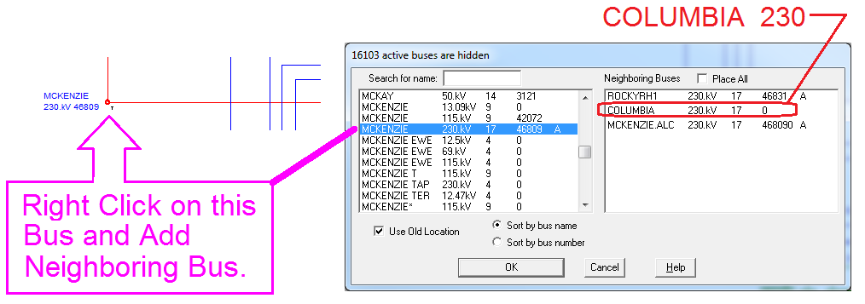
Add BPA Line/Bus to Zone 13 Bus
The COLUMBIA Bus is a neighboring BPA bus

Slide 23
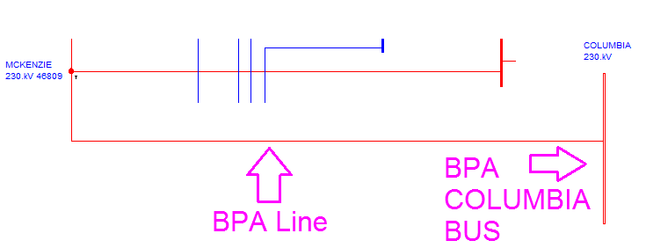
Sample Addition of Foreign Equipment
Here the BPA Columbia Line & Bus is added and more equipment can be UN-HIDDEN as Needed.

Slide 24
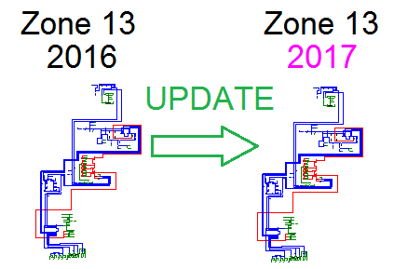
Updating Zone 13 Year to Year

Slide 25
Model Updating Steps in OneLiner
Update in manageable Steps (Breakers & Relays)*
Suggested order
Circuit ID on all equipment with Circuit ID First.
Buses, (Names, Area Number, Zone Number)
Transformers, (Parameters)
Lines, (Parameters)
Generators (Parameters)
Switches, Caps, Reactors
Mutual Impedances

Slide 26
Adding non-ASPEN data to ASPEN
ASPEN has Conversion programs to convert foreign data to ASPEN .DXT format.
Non ASPEN programs may have conversion program to convert to ASPEN data format.
When foreign data is applied to OneLiner it is best to build a new ASPEN model in a new blank palette.
When new model is complete, copy it your working ASPEN model.

Slide 27
Comparing Bus Faults Non-ASPEN
Island the system that is not from an ASPEN model.
Run bus fault summaries at all the Boundary Buses in ASPEN model (BPA Regional Model)
Request same bus fault summary from non-ASPEN modeler program.
Compare bus fault summaries.
Resolve differences.

Slide 28
Sharing Regional Model
Users of the Regional model should honor the confidentiality of other contributors.
The Regional model should not be shared outside of the Regional Community without permission from the Regional Model manager.
Exceptions would be Engineering Contracting Consultant doing specific work for a utility.
Reducing Hidden equipment to equivalents is encouraged.

Slide 29
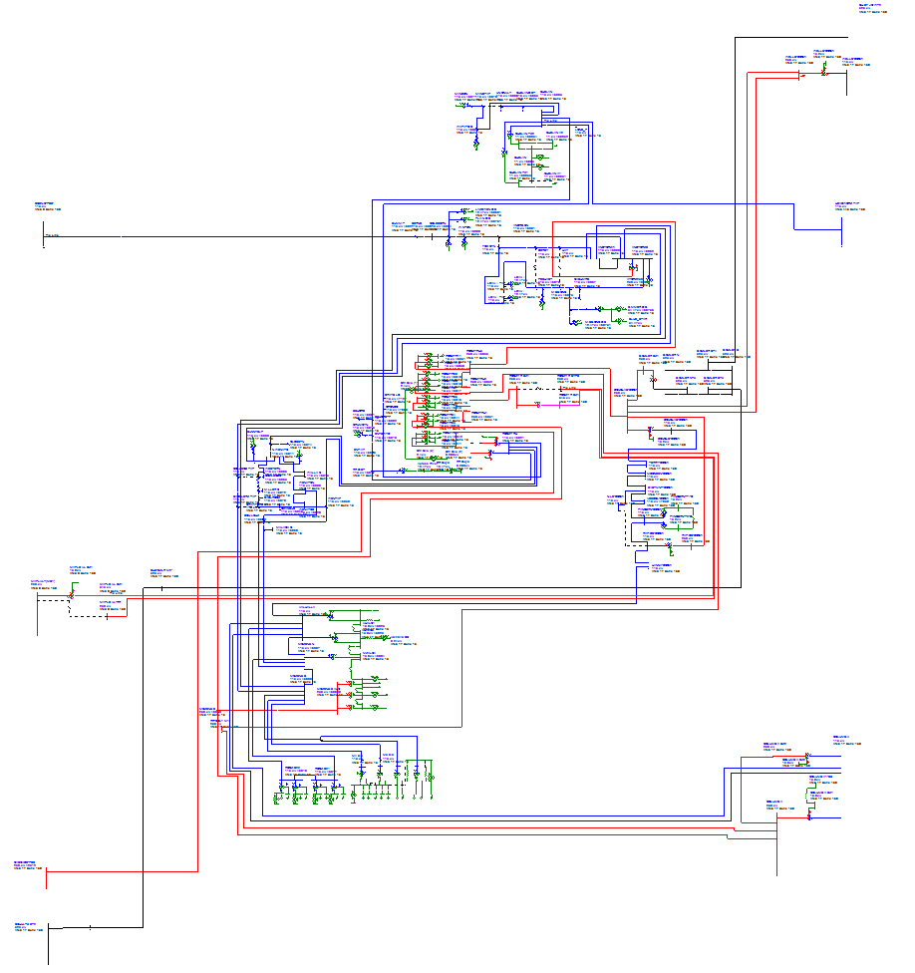
Zone 13 Equivalent circuits Hidden

Slide 30
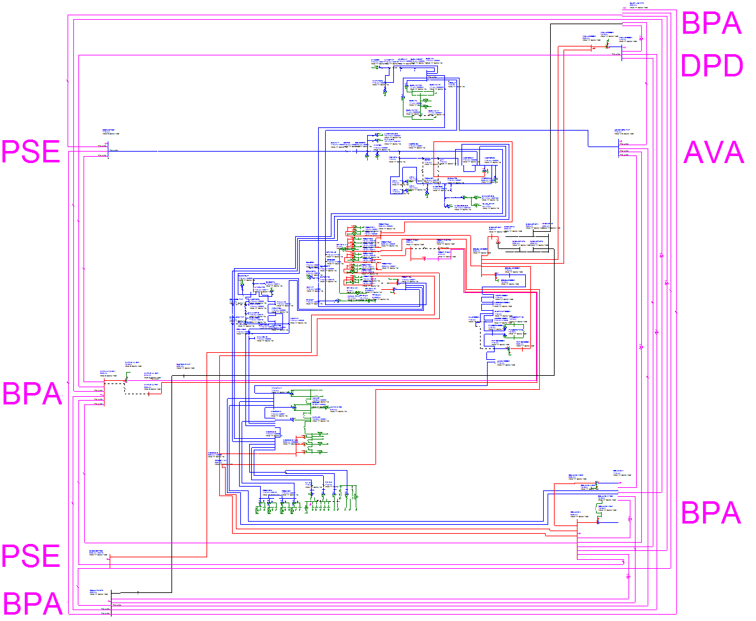
Zone 13 Expanded & Region Reduced

Slide 31
Final Policy on Regional Model
The BPA model is a snapshot in time based on current and best estimated equipment values at the time of annual distribution.
The BPA model is intended to show all current equipment and future equipment that is budgeted and in the process of being constructed.
All long term future modeling is performed by planners using the Annual Regional model as a basecase.
There is no practical way to link the BPA Regional model to any large Regional power flow program.

Slide 32
Questions ?

Slide 33
In Conclusion Remove Cloud Mystery
Don’t Become a Victim of the Cloud.
Look into Cloud as much as necessary for Post Fault Analysis.
Update with confidence.

